Slide 1

USA SASE
HACKATHON

Slide 2


USA SASE HACKATHON
WHAT IS A HACKATHON?
Hackathons is a social event where teams or individuals design a project as programmers within a specified time frame to solve the given prompt’s problem in a competition which concludes into giving to a panel. Our Hackathon is also geared to also present other prompts for other majors to solve which will include the same benefits so anyone regardless of major or year can participate!
WHAT DO YOU BENEFIT?
Cash pool is $500 ($250 per prompt)
Helps build onto your resume and technical background (Free project)
Provides opportunities for networking, collaboration, and getting noticed by internships from Hackathon portfolio

Slide 3
WHAT TO EXPECT
TIME FRAME Since the hackathon is completed as an event in one session. Check-in will begin from 10:00 am and the Hackathon will conclude at 4:00 pm. | FOOD Free food and drinks will be provided throughout the Hackathon as a food bar. | RESOURCES You will be able to use the Internet as resources to help yourself. (Remember your code is judged more than just the code itself so many other aspects come into play too)
TEAMS You are able to enter the hackathon by yourself, with a partner, or a team (must not exceed 5 people) | DATE March 29th (Saturday) | LOCATION Shelby Hall Room 2214

Slide 4
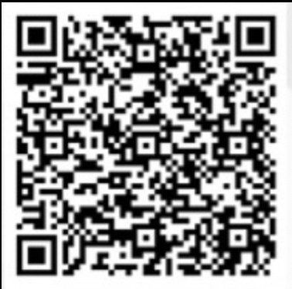

REGISTRATION
Interested in participating in SASE’s Hackathon? Make sure to head to our registration and sign yourself up to be part of University of South Alabama’s SASE second Hackathon. Registration methods are listed below. You must register in order to attend the Hackathon event. (No entry free required)
Linktr.ee
Google link
QR Code
linktr.ee/sase_usa
https://docs.google.com/forms/d/1jVnVkkEhxoILfeav0zlSMZ6ptchteYrO6pa884TNFVQ/viewform

Slide 5
PRE-HACKATHON WORKSHOP
Interested in participating in our upcoming Hackathon?
Attend our workshop!
March 27th, Thursday
Shelby Hall Room 2214
6:00 pm - 7:30 pm

Slide 6



CONTACT US
E-MAIL
INSTAGRAM
DISCORD
@sase_usa
https://discord.gg/8wKsbsFpTc
southalabama@saseconnect.org
Or just ask me lol

Slide 7

QUESTIONS?

